Slide 1
Welcome to Marketing Management
Dr. Cecilia Ruvalcaba
BUSI 107 Week 2, Day 1

Slide 2

Way to go Coke!
By 2050, our oceans will hold more plastic than fish
http://www.usatoday.com/story/news/2016/01/24/oceans-more-plastic-than-fish/79267192/

Slide 3
Chapter 1: Overview of Marketing cont… & Chapter 2: developing Marketing Strategies

Slide 4




American Marketing Association
“the activity, set of institutions, and processes for creating, communicating, delivering, and exchanging offerings that have value for customers, clients, partners, and society at large.

Slide 5
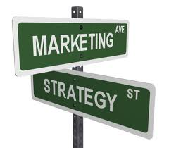
The Marketing Concept
“An organization should seek to make a profit by serving the needs of customer groups.”
Customer Value Orientation
Customer Needs
Exceptions?
Selling Orientation
Production Orientation

Slide 6
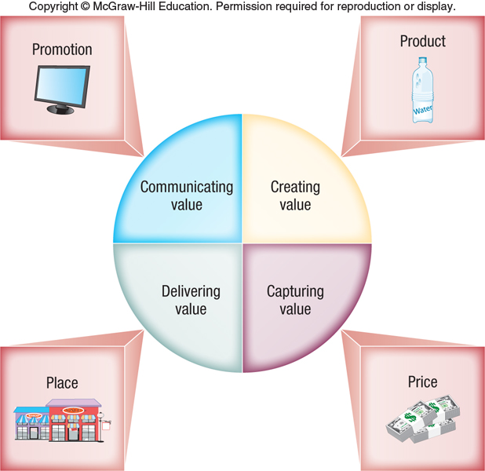

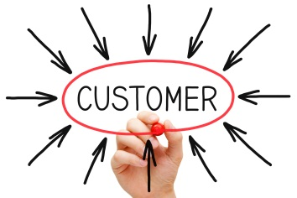

Slide 7
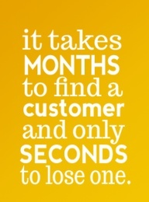
The Long-Term Value of loyal customers
It costs a great deal more to acquire a new customer than to keep an old one.
Loyal customers buy more from your firm over time.
The longer you keep a customer, the more profitable they become over time.
It costs less to service loyal customers than new customers.
Loyal customers are often excellent referrals for new business.
Loyal customers are often willing to pay more for the quality and value they desire.

Slide 8
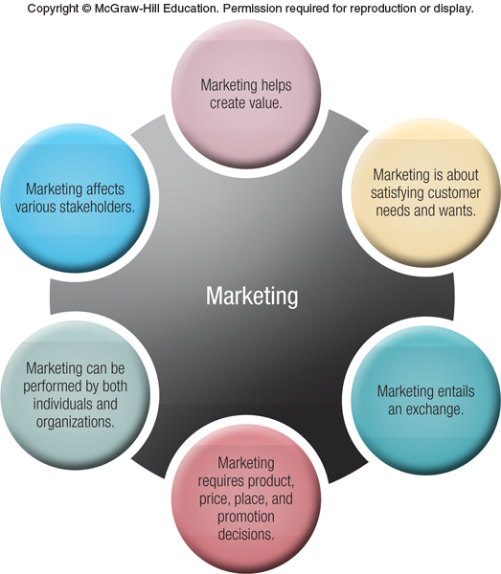

Slide 9



Strategic Planning
Over ¾ of the 100 largest U.S. Companies of 70 years ago have fallen.
Business Strategies:
Reflect Changing Environments
Continuous Improvement.
True mission of an organization is to provide value for three key constituencies:
Customers
Employees
Investors
The Mission, Objectives, Strategies and Portfolio Plan established at the top level provide context for planning in each of the divisions and departments.

Slide 10
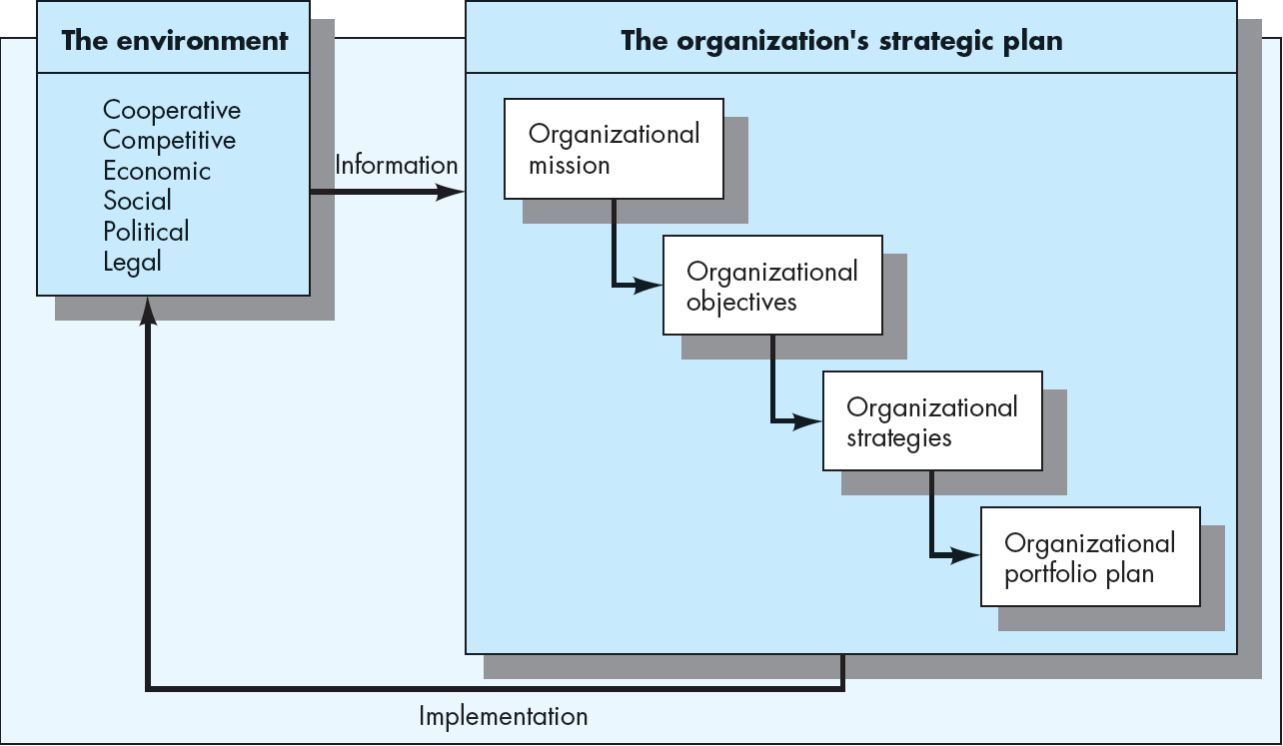
The Strategic Planning Process
Focus
Goals
Culture
Technology
Industry
Direction

Slide 11
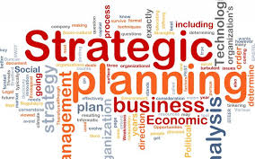
Complete Strategic Plan
Facilitates development of marketing plans for each product, product line, or division of the organization
Marketing plan serves as a subset of strategic plan

Slide 12
The marketing management process
Business Mission Statement
Process of planning and executing the conception, pricing, promotion, and distribution of goods, services, and ideas to create exchanges with target groups that satisfy customer and organizational objectives
Objectives
Situation or SWOT Analysis
Marketing Strategy
Target Market Strategy
Marketing Mix
Product
Distribution
Promotion
Price
Implementation Evaluation Control

Slide 13

Take Away for Today
Marketing Management… It’s all about the Customer!
What value are you providing?
You need a plan!
Pre-Planning for Success
(Focus, Goals, Direction)

Slide 14

Next Class
Chapter 2: Marketing Strategies and the Marketing Plan (continued)
Chapter 10: Marketing Research
Syllabus Agreement
Submit Groups

